Slide 1

Networks Fundamentals
Mousa Al-Sahory

Slide 2
Chapter 5
OSI vs TCP/IP
OSI Layers

Slide 3
Network Fundamentals
OSI vs TCP/IP

Slide 4
OSI model vs TCP/IP model
The Open Systems Interconnection (OSI) model is a reference tool for understanding data communications between any two networked systems.
TCP/IP are two protocols of this model. TCP stands for Transmission Control Protocol and IP stands for Internet Protocol.
The OSI model consists of 7 architectural layers whereas the
TCP/IP only has 4 layers.
OSI is a reference model and TCP/IP is an implementation of OSI model.
The OSI model however is a "generic, protocol-independent
standard.

Slide 5
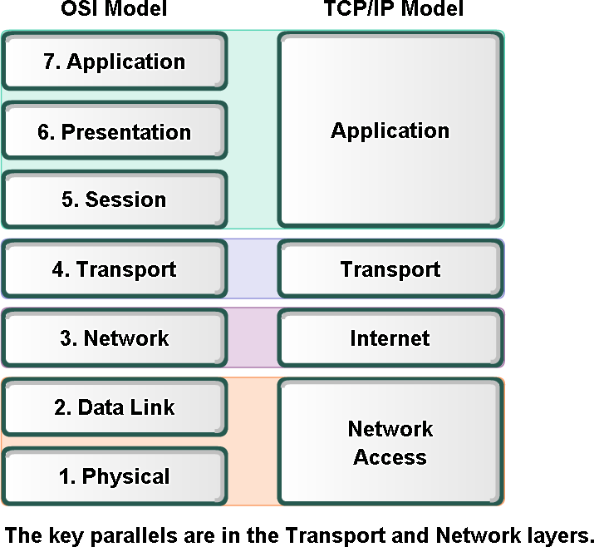
OSI Model vs TCP/IP Model

Slide 6
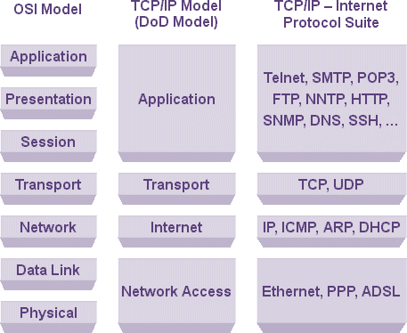
OSI Model vs TCP/IP Model

Slide 7
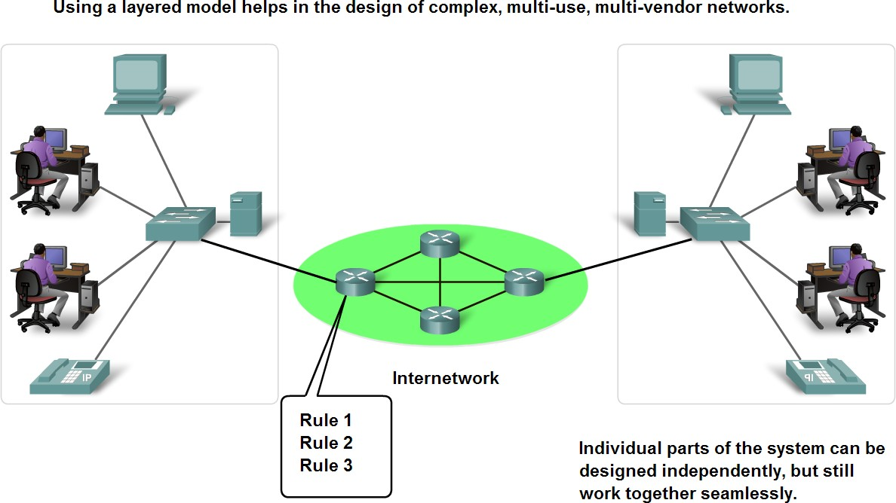
Layers with TCP/IP and OSI Model
Why do we need layered system
  Reduces complexity (design, maintenance, troubleshooting)
  Allows to use different media and protocols
  Allows standardization (multi-vendor)
  Fastens evolution (for example Ethernet)

Slide 8
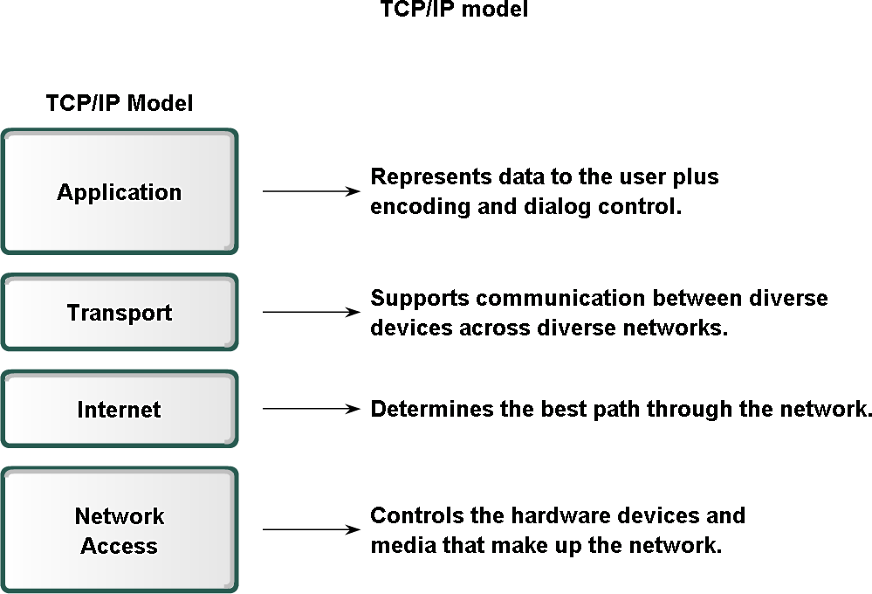
Layers with TCP/IP and OSI Model

Slide 9
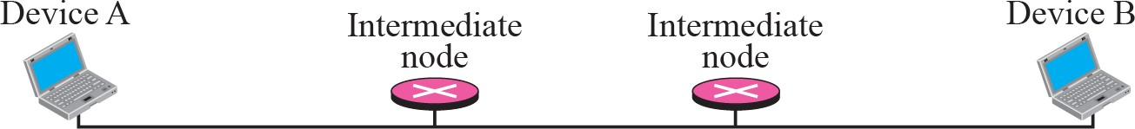
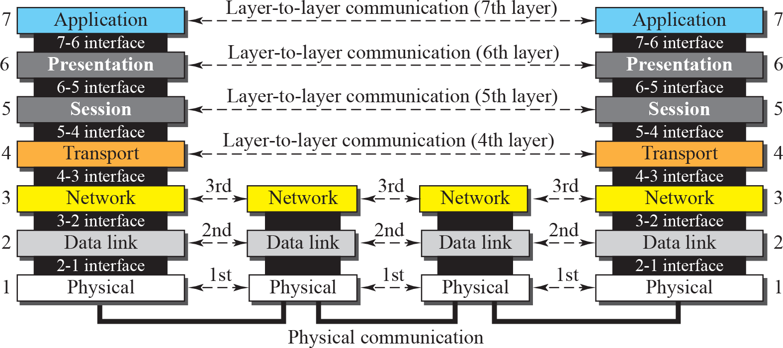
Layers with TCP/IP and OSI Model
OSI Reference Model
Data unit | Layer | Function
Data | 7. Application | Network process to application
 | 6. Presentation | Data representation and encryption
 | 5. Session | Host-to-host communication
Segment | 4. Transport | End-to-end connections and reliability
Packet | 3. Network | Path determination and logical addressing
Frame | 2. Data Link | Physical addressing
Bit | 1. Physical | Media, signal and binary transmission

Slide 10
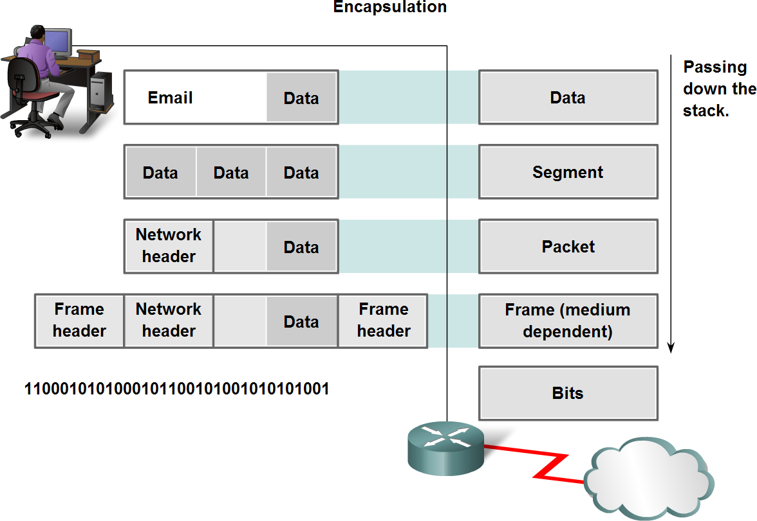
Layers with TCP/IP and OSI Model
Protocol data units (PDU) and encapsulation

Slide 11
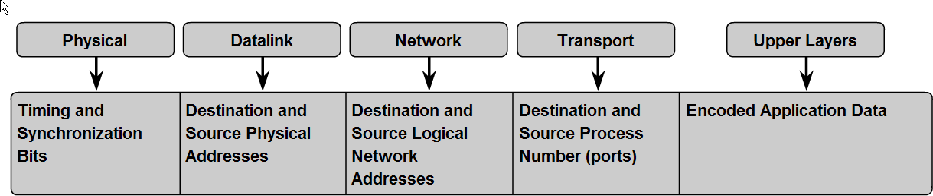
Layers with TCP/IP and OSI Model

Slide 12
Layers with TCP/IP and OSI Model

Slide 13
Layer 1
Physical Layer

Slide 14
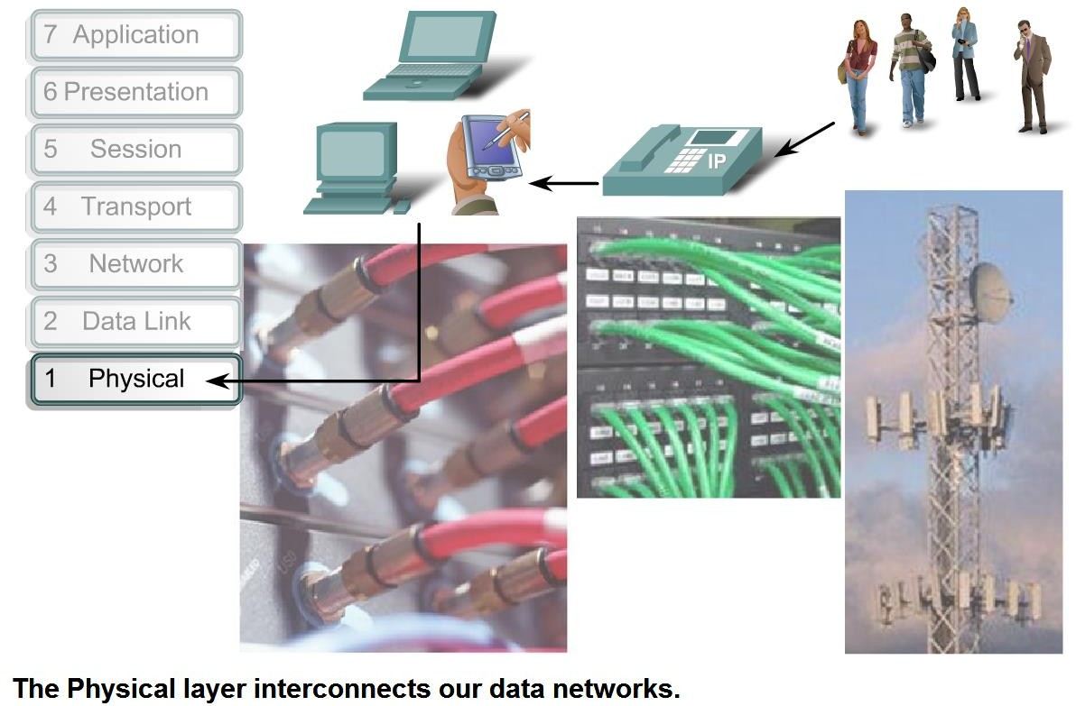
Physical Layer Protocols & Services

Slide 15
Physical Layer Protocols & Services
Physical Layer is responsible for transmitting row bit stream over the physical cable.
Specifies electrical, mechanical requirements required for maintaining the physical link.
PDU at physical layer is (bits).
The nearest layer to the media.
Functions:
  Data encoding
  Transmission technique (modes) → Simplex, half duplex or full duplex
  Physical medium transmission
  Modulation
  Multiplexing :is a way of sending multiple signals or streams of information over a communications link at the same time in the form of a single, complex signal.
  Bit synchronization
  Manage physical connection
  Bit rate control
  Line configuration → Point-to-point, multipoint or point-to-multipoint
  Physical topology → bus, ring, mesh or star network
Concerned about the medium types → Copper, Fiber Optics, Wireless … etc

Slide 16
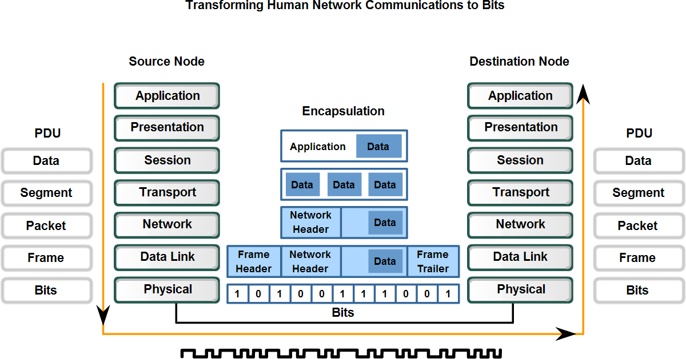
Physical Layer Protocols & Services

Slide 17
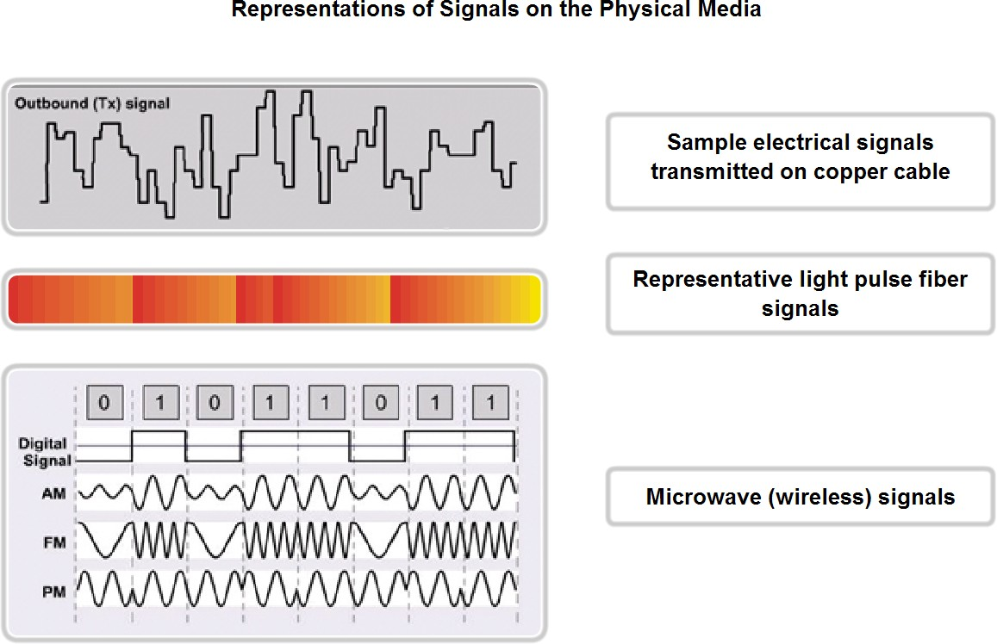
Physical Layer Protocols & Services

Slide 18
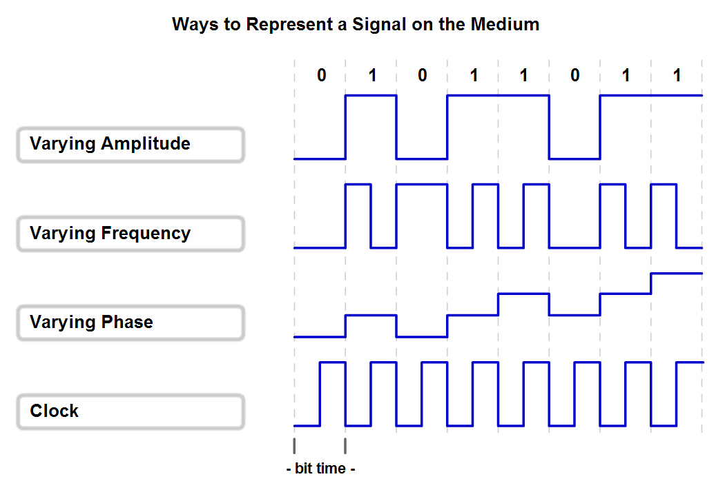
Physical Layer Signaling and Encoding
Examples of encoding techniques

Slide 19
Layer 2
Data Link Layer

Slide 20
Data Link Layer – Accessing the Media
Data link layer is responsible to provide an error-free transmission of information between two end stations.
Functions:
  Link establishment and termination
  Frame traffic control
  Physical addressing (MAC addressing)
  Frame sequencing through the use of FCS (Frame Check Sequence)
  Error Detection through the use of CRC (Cyclic Redundancy check)

Slide 21
Data Link Layer – Accessing the Media
PDU at data link layer is (frame)
Layer 2 switching happens at data link layer.
Encapsulation of network layer data packets into frames
    Error Control
      Error Detection
      Error Correction
      Retransmission
      Flow Control

Slide 22
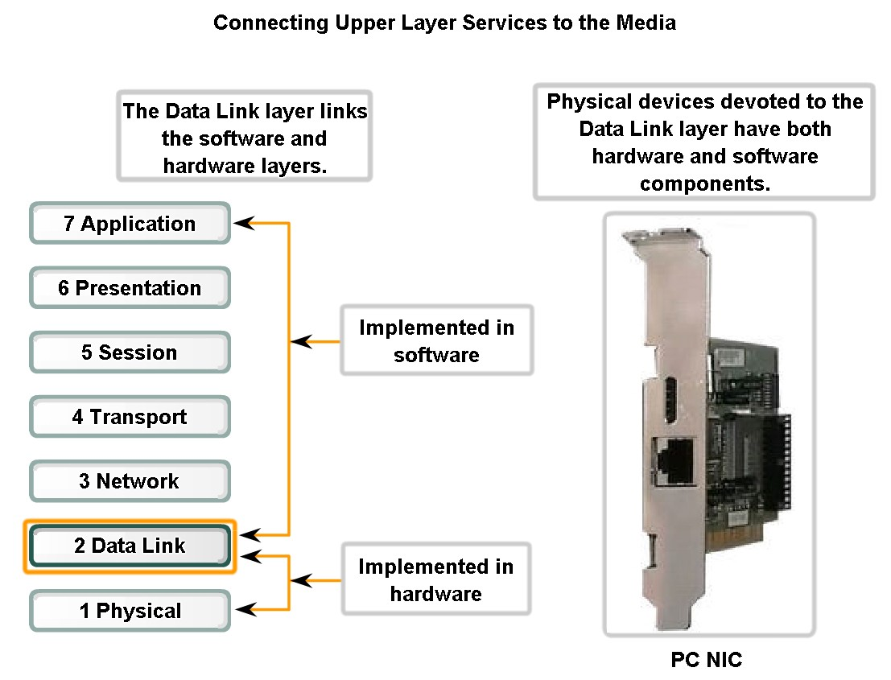
Data Link Layer – Accessing the Media
Data Link layer links the software and hardware layers

Slide 23
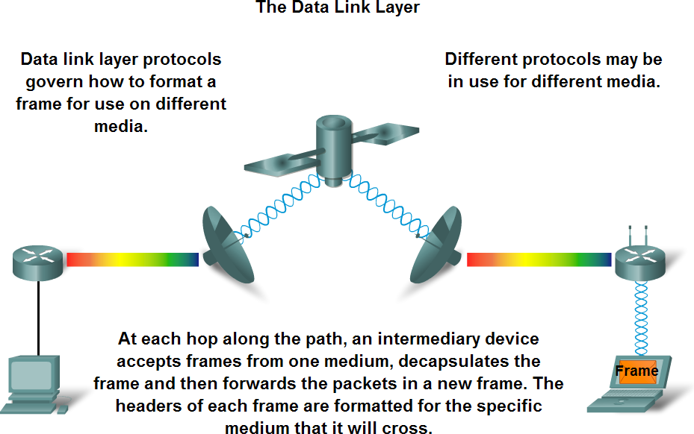
Data Link Layer – Accessing the Media
Data Link layer protocols are required to control media access

Slide 24
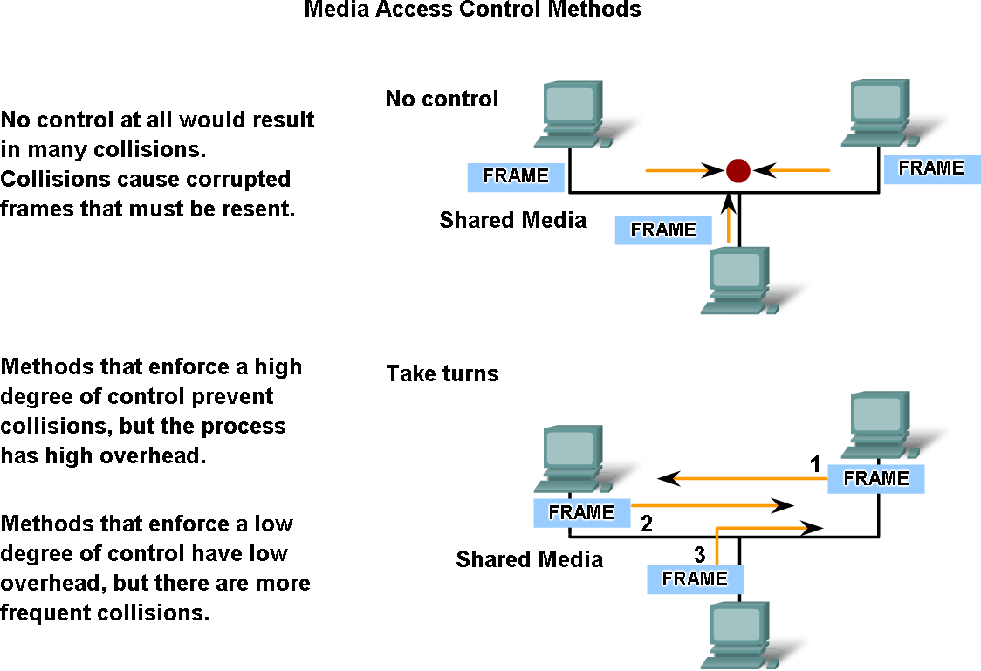
MAC Multiple Access Techniques

Slide 25
MAC Multiple Access Techniques
Fixed assignment
  Partition channel so each node gets a slice of the bandwidth – Channel Based.
  Essentially circuit switching – thus inefficient
  Protocol examples: TDMA, FDMA, CDMA (all used in wireless/cellular environments – 3G/4G/WiMAX/Blutooth)
Contention-based
  Nodes contends equally for bandwidth and recover from collisions
  Protocol examples:
    CSMA/CD (used in Ethernet/IEEE 802.3)
    CSMA/CA (used in IEEE 802.11/WiFi WLANs)
    The Aloha Protocol
Token-based or reservation-based
  Take turns using the channel
  Protocol examples:
    Token bus (IEEE 802.4)
    Token ring (IEEE 802.5)
    Token passing (used in FDDI)

Slide 26
IEEE Standards
IEEE 802.1: Standards related to network management.
IEEE 802.2: It defines Logical Link Control (LLC), which is the upper sub-layer of the data link layer of the OSI Model.
IEEE 802.3: Defines the MAC layer for bus networks that use
CSMA/CD. This is the basis of the Ethernet standard.
IEEE 802.4: Defines the MAC layer for bus networks that use a token-passing mechanism (token bus networks).
IEEE 802.5: Defines the MAC layer for token-ring networks.
IEEE 802.6: Standard for Metropolitan Area Networks (MANs)
IEEE 802.11: standard for Wireless LAN (WLAN) & Mesh (Wi- Fi certification)
IEEE 802.16: standard for WiMAX

Slide 27
Ethernet
Most popular packet-switched LAN technology
LAN standards define MAC and physical layer connectivity
  IEEE 802.3 (CSMA/CD - Ethernet) standard for 10Mbps
  IEEE 802.3u standard for 100Mbps Ethernet → Fast Ethernet
  IEEE 802.3z standard for 1,000Mbps Ethernet → Gig Ethernet
  IEEE 802.3ae standard for 10Gbps Ethernet
CSMA/CD: Ethernet’s Media Access Control (MAC) policy
CS = carrier sense → Send only if medium is idle MA = multiple access
CD = collision detection →Stop sending immediately if collision is detected

Slide 28
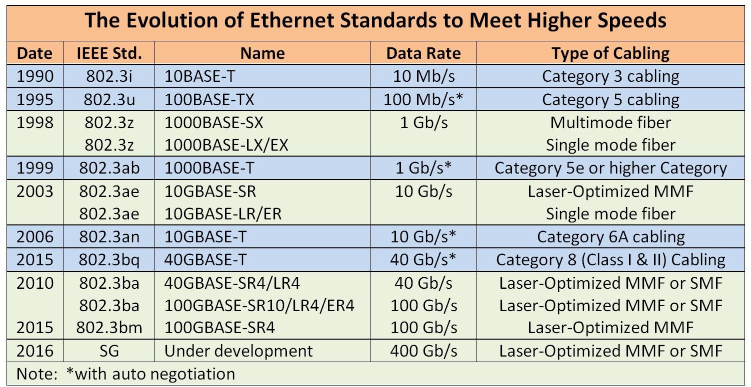
Ethernet

Slide 29

Ethernet
Ethernet by definition is a broadcast protocol
  Any signal can be received by all hosts
  Switching enables individual hosts to communicate
Network layer packets are transmitted over an Ethernet by
encapsulating
Frame Header Format

Slide 30
Ethernet
Preamble is a sequence of 7 bytes, each set to “10101010” → Used to synchronize receiver before actual data is sent
MAC addresses
Type field is a de-multiplexing key used to determine which higher level protocol the frame should be delivered to
Body can contain up to 1500 bytes of data

Slide 31
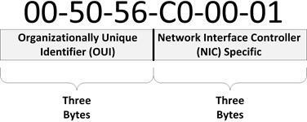
MAC Address
Unique, 48-bit unicast address assigned to each adapter (12
in Hex)
Physical address
Each manufacturer gets their own address range
Cant be changed
broadcast: all 1s
multicast: first bit is 1

Slide 32
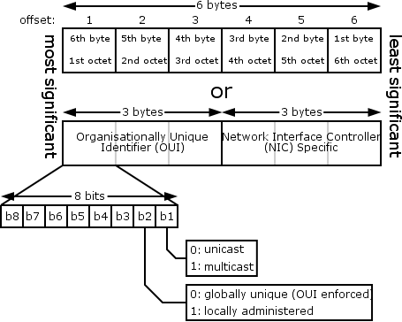
MAC Address

Slide 33
Cyclic Redundancy Check (CRC)
Used for error detection.
CRC has 2 methods:
  Division method: Data is divided by a random number. The random number is placed in the first flag and the remainder of the division in the second flag, when data is received at the destination, it is divided by the random number in the first flag and the remainder should be the same as the one in the second flag.
  Parity check: number of 1’s in the data is counted, if it is even a Zero is placed at the flag, and if it is odd a 1 is placed at the flag. At the destination, the number of 1’s in the received data is compared to the flag.
A problem might occur if two 1’s are lost, then the parity check won’t work, that is why both of the methods “parity check and division method” are used together.

Slide 34
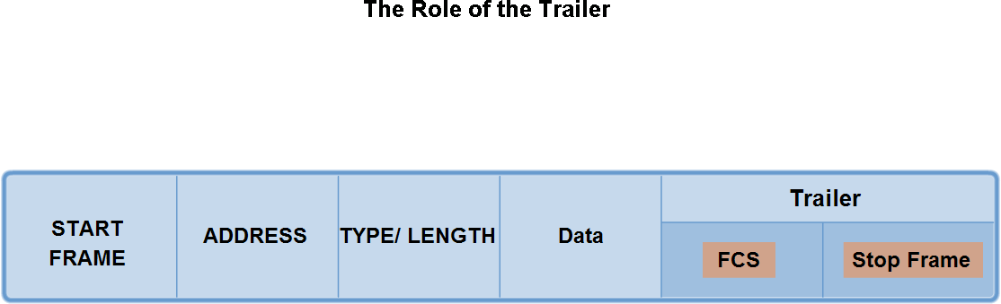
Frame Check Sequence (FCS)
Each frame is given (assigned) a certain number.
If frames arrives out of order, the frame sequencing number
is used to rearrange the frames in the correct order.
If an error is detected within a frame (corrupted), the frame number is used to inform the transport layer to retransmit the corrupted frame.

Slide 35
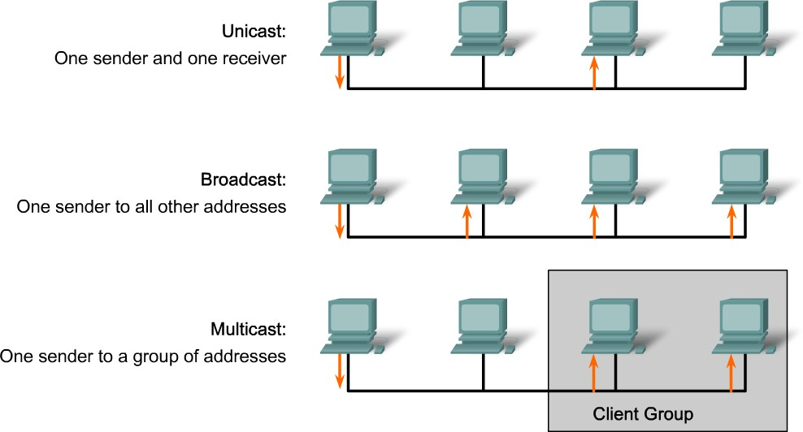
Types of Traffic Transmission

Slide 36
Collision Domain
Collision is the effect of two nodes sending transmissions simultaneously in Ethernet.
When they meet on the physical media, the frames from each node collide and are damaged.
Collision Domain is the network area in Ethernet over which
frames that have collided will be detected.
Collisions are propagated by hubs and repeaters
Collisions are Not propagated by switches, routers, or bridges

Slide 37
Collision Domain
A collision domain is the segment where devices must compete to communicate.
  All ports of a hub belong to the same collision domain.
  Every port of a switch is a collision domain on its own.
  A switch break the segment into smaller collision domains, easing device competition.

Slide 38
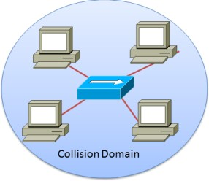
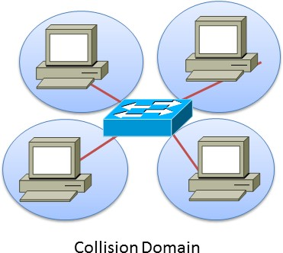
Collision Domain

Slide 39
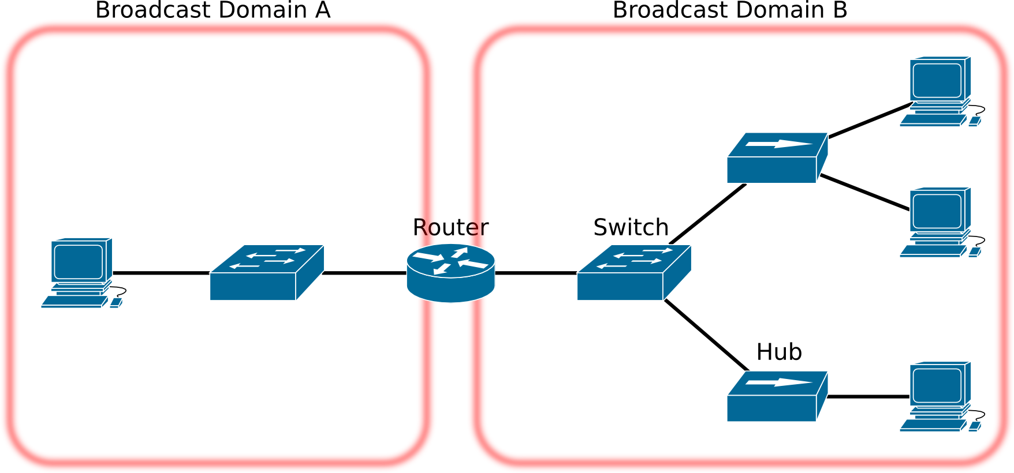
Broadcast Domain
A group of devices receiving broadcast frames initiating from
any device within the group
Routers do not forward broadcast frames, broadcast
domains are not forwarded from one broadcast to another.

Slide 40
Broadcast Domain
A broadcast domain is the extend of the network where a broadcast frame can be heard.
  Switches forward broadcast frames to all ports; therefore, switches do not break broadcast domains.
  All ports of a switch, with its default configuration,
belong to the same broadcast domain.
  If two or more switches are connected, broadcasts are forwarded to all ports of all switches, except for the port that originally received the broadcast.

Slide 41
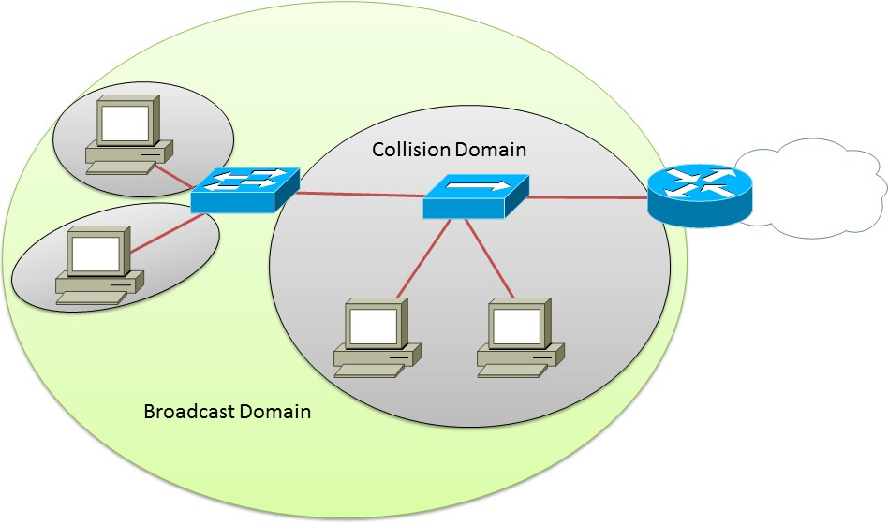
Collision Domain & Broadcast Domain

Slide 42
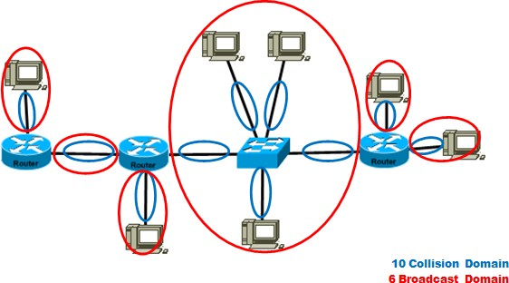
Collision Domain & Broadcast Domain

Slide 43
Q&A

